Slide 1
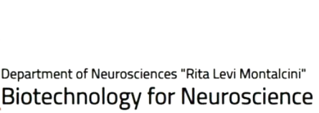
Area:
Laboratory
Professor: Luca Bonfanti
luca.bonfanti@unito.it
SSD: VET01

Slide 2
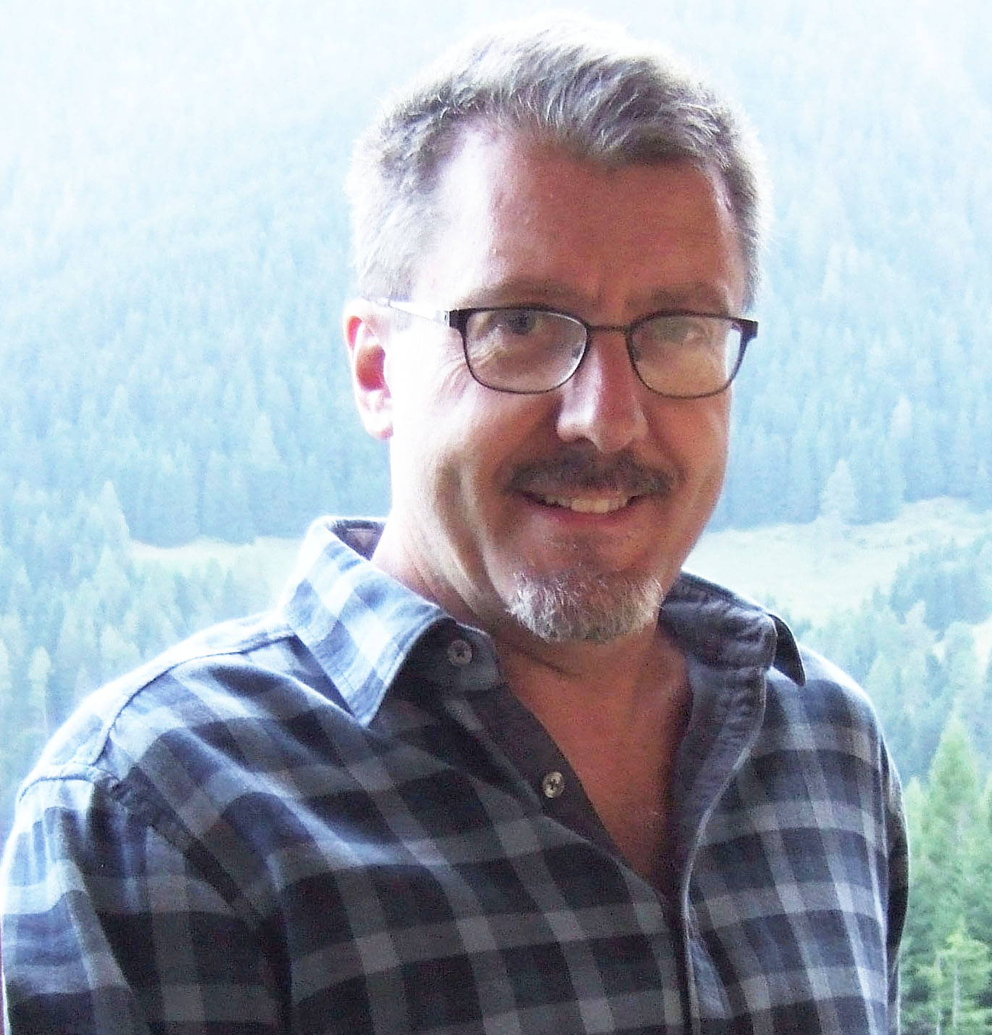
Objective of the internship
To introduce the student in the research field of brain structural plasticity, with special reference to neurogenic processes occurring in the mature brain and to the comparative approach in different mammals
Research lines
The research lines are linked to the recent discovery of «immature» or «dormant» neurons: cells generated prenatally and blocked in arrested maturation for long time, until they «awake» to fully mature and integrate into preexisting circuits
Phylogenetic variation of immature neurons in mammals (cerebral cortex and amygdala)
Possible modulation of immature neurons in different physiological conditions
Comparative analysis of cell proliferation in parenchymal brain regions hosting immature neurons

Slide 3
Area:
Laboratory
Professor: Marilena Marraudino
marilena.marraudino@unito.it
SSD: BIO/16

Slide 4
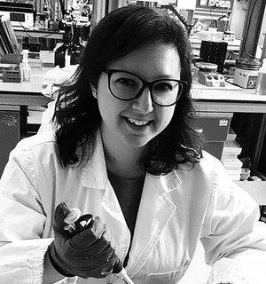
Objective of the internship
The project aims to investigate the possible consequences of the use of phytoestrogens, in particular , genistein (GEN), associated with a low-protein diet during pregnancy in a pathological condition of anorexia nervosa (AN).
Research lines
Diet and lifestyle during pregnancy are crucial for the health of the mother and the optimal development of the fetus, and can also affect the health of the offspring in adulthood by increasing or decreasing the risk of chronic diseases such as obesity, diabetes, and delayed neurodevelopment.
Phytoestrogen intake during pregnancy, as well as stress, could cause changes in gene expression (i.e. how much a gene is 'switched on' or 'switched off') in the early stages of fetal development. These changes could explain an increased susceptibility to the onset of neuroendocrine changes in adulthood.
The results will be important in food safety and human health, trying to shed light on the role of phytoestrogens during the development of hormone-regulated nerve circuits in the fetal period.

Slide 5
Area:
Laboratory
Professor: Benedetto Sacchetti
benedetto.sacchetti@unito.it
SSD: Fisiologia BIO/09

Slide 6
Objective of the internship
The aim of the internship is to provide students with the theoretical and practical knowledge for conducting research in the field of emotions and memory, with particular reference to emotionally salient memories and processes of fear and anxiety.
Research lines
Cellular mechanisms of emotional memories
Neural circuits of emotional memories
Neuronal mechanisms of emotional disorders (anxiety disorders, PTSD)
The research activity focuses on the brain mechanisms of fear and anxiety and the formation of traumatic memories. The main objective is to understand the neural mechanisms of emotional memory formation at both the cellular and circuit levels, and to provide new insights into the neurobiological basis of emotional and behavioral disorders associated with these processes.
To address these issues, a multidisciplinary approach is employed that combines behavioral studies, in vivo optogenetic and chemogenetic techniques, in vivo pharmacological manipulations, in vivo electrophysiological recordings, and ex vivo molecular biology and confocal microscopy techniques.

Slide 7
Area:
Laboratory
Professors: Giordano Roberta , Giulio Mengozzi
roberta.giordano@unito.it
giulio.mengozzi@unito.it
SSD:Med/13

Slide 8
Objective of the internship
Application of liquid chromatography coupled with tandem mass spectrometry for the biomarker profiling in neuro-endocrinology.
.
Research lines
Analytical validation of multimarker approach (i.e. proteomic, metabolomic, steroidomic)
Clinical validation for the traslational application of novel biomarkers in the clinical setting
Definition of biomarker profiles for distinct clinical entities

Slide 9
Area:
Laboratory
Professor: Massimo Collino
massimo.collino@unito.it
SSD: Pharmacology

Slide 10
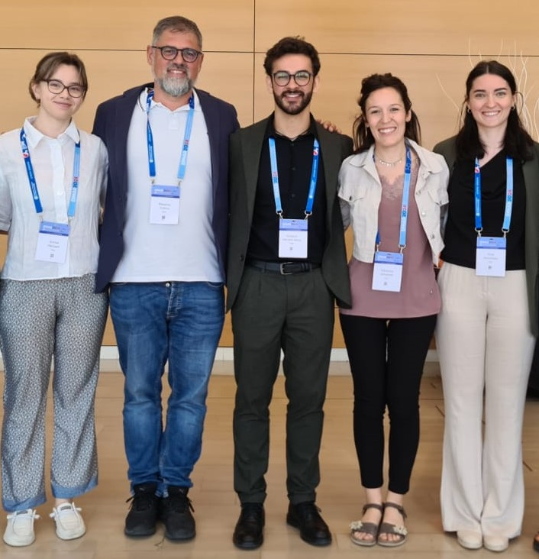
Objective of the internship
The project involves the development of in-vitro and in-vivo experimental models.
Students will be involved in performing biomolecular assays (including western blot, RT-qPCR, histologic stainings and immunodetections) on cellular and animal samples to unravel the biomolecular mechanisms underlying acute inflammatory damages and blood-brain barrier impairments.
.
Research lines
Drug targeting of sepsis-related encephalopathy
The project aims to identify new pharmacological targets to counteract the multi-organ failure induced by sepsis, focusing on the impact of sepsis on central nervous system disorders and blood brain barrier integrity.

Slide 11
Objective of the internship
Students will be involved in performing biomolecular assays (including western blot, RT-qPCR, histologic stainings and immunodetections) from experimental models of metaflammation to identify proteins involved in the progression of neurometabolic injury and the effects of their pharmacological targeting.
.
Research lines
Impact of diet on brain glucose metabolism and cognitive impairments
The project aims to investigate the deleterious effects of the excessive consumption of hypercaloric diets, leading to a state of low-grade chronic inflammation (“metaflammation”) both in peripheral and central districts of the organism.
created with BioRender.com

Slide 12
Area:
Laboratory
Professor: Marina Boido
marina.boido@unito.it
SSD: BIO/16 Human Anatomy

Slide 13
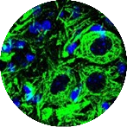
Objective of the internship
By using different experimental techniques, the student will learn the anatomy of the central nervous system and the main pathogenetic mechanisms underlying some neurodegenerative pathologies, with particular attention to motor neuron diseases (Amyotrophic Lateral Sclerosis and Spinal Muscular Atrophy).
The student will learn how to :
process and analyze the biological samples,
master the main techniques for the study of nervous tissue preparations (immunohistochemistry, morphometric analyses, 3D reconstructions, microscopy),
know the employed experimental models and iv) recognize the cellular alterations correlated to pathogenetic mechanisms.
Research lines
Unravelling morpho-functional alterations in experimental models of motor neuron diseases
Testing new therapeutic approaches for ALS and SMA

Slide 14
Area:
Laboratory
Professor: Enrica Boda
enrica.boda@unito.it
SSD: Human Anatomy

Slide 15
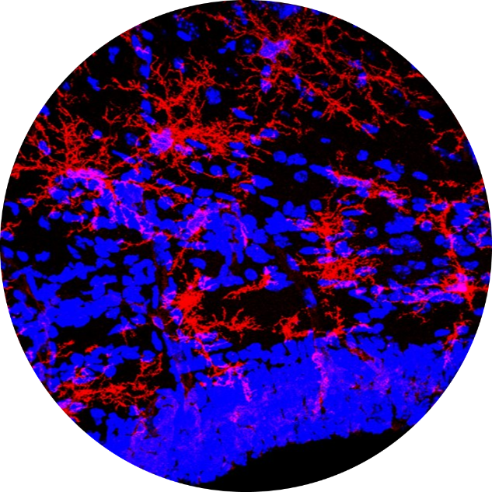
Objective of the internship
Oligodendroglia and myelin physiopathology
Research lines
.
Molecular mechanisms involved in oligodendrocyte biology and heterogeneity
Neurodevelopmental disorders associated with dys-/hypo-myelination
Treatment approaches for demyelinating diseases
Myelin plasticity
Approaches:
In vivo immunohistological analyses; Behavioral analyses; Gene expression analyses; Lineage tracing and mouse transgenesis; Primary cell cultures

Slide 16
Area:
Laboratory
Professor: Annalisa Buffo
annalisa.buffo@unito.it
SSD: Physiology

Slide 17
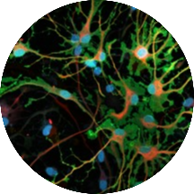
Objective of the internship
Astrocyte development and physiopathology
.
Research lines
Development and diversification of rodent and human astrocytes
Astrocyte contribution to brain functions and pathology
Astrocyte-oligodendrocyte- interplay
Approaches:
Single cell/single nuclei omics; In vivo immunohistological analyses; Behavioral analyses; Lineage tracing and mouse transgenesis; human 2D cultures and organoid models of healthy and diseased pluripotent stem cell-derived neural cells.
Credits: M. Lorenzati

Slide 18
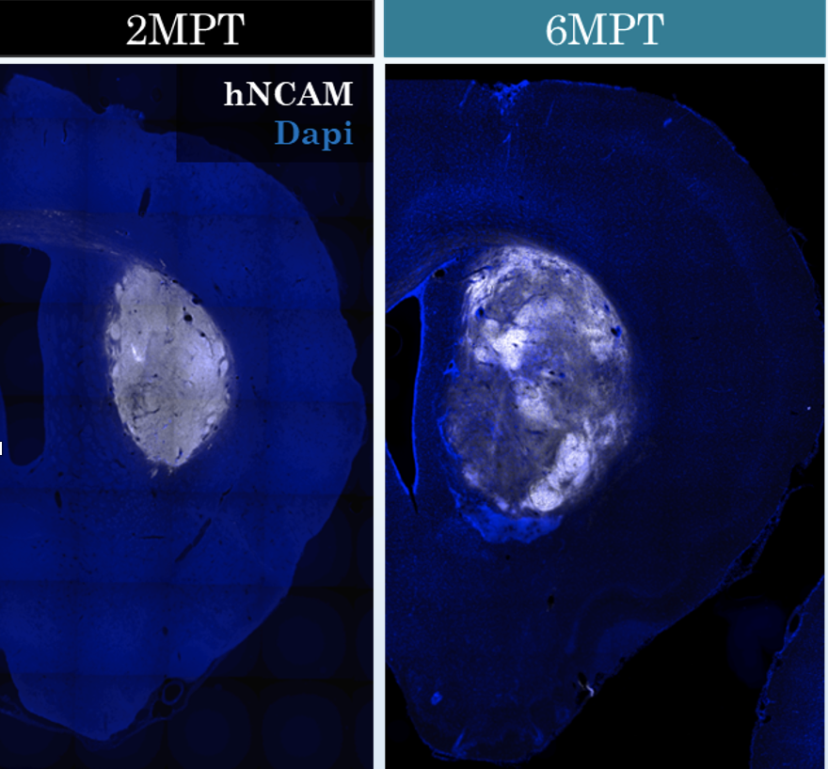
Objective of the internship
Cell replacement and brain re-wiring in neurodegenerative diseases
.
Research lines
Integration of human striatal grafts in models of Huntington’s disease
Impact of training protocols and enriched environment on damaged circuits re-wiring
Host-graft interplay
Approaches:
Generation of disease models; Microsurgery; In vivo immunohistological analyses; Behavioral studies; Transinaptic tracing; Clearing technologies and analytic pipelines for cleared brains.
Credits: M. Ribodino, R. Parolisi

Slide 19
Area:
Laboratory
Professor: Maurizio Giustetto
maurizio.giustetto@unito.it
SSD: Bio/16

Slide 20
Objective of the internship
Assessing cellular and molecular determinants of sensory in a rare neurodevelopmental disorder.
Research lines
Autistic traits may arise from atypical sensory experience during postnatal life, but whether there is a causal link between defects in cortical circuitry in the brain, altered sensory processing and social behavior remains unknown. The student will investigate this topic by studying the circuitry underlying tactile responses in both murine and in-vitro models of CDKL5 deficiency disorder. Such multidisciplinary approach will include: behavioral testing, neuroanatomy, electrophysiology, high resolution confocal imaging and connectomic analyses, as currently used in the laboratory.

Slide 21
Objective of the internship
To investigate extracellular vesicles-mediated cell-to-cell communication in brain development and disease.
Research lines
The mechanisms underlying EVs regulation of synaptic circuits formation and plasticity are currently unknown. EVs contents (e.g., proteins, mRNAs and miRNAs) reflects both physiological and pathological condition of the releasing cells, thus representing a promising source of still unknown molecules regulating brain development and disease-specific biomarkers.
The student will learn how to:
isolate and purify EVs from bodily fluids or neuronal culture (including iPSC cells), and morphologically as well as molecularly validate their identity (using electron microscopy and nanosight imaging);
analyze exosomes cargo by multiOmics, and functionally test their neuronal function by analyzing synaptic transmission and connectivity

Slide 22
Area:
Laboratory
Professor: Serena Stanga
serena.stanga@unito.it
SSD: BIOS-12/A Anatomia umana

Slide 23
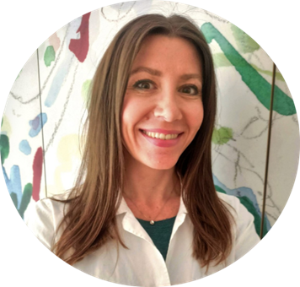
Objective of the internship
Study of the degenerative processess associated to healthy brain aging and neurodegenerative diseases, especially Alzheimer’s disease (AD), Amyotrophic Lateral Sclerosis (ALS) and Spinal Muscular Atrophy (SMA).
Research lines
mitochondrial morpho-functional dysfunctions in the CNS during aging and disease
iron metabolisms during brain aging and dementia and CNS targeted therapies
AD-related proteins functions and the impact on neurotrophic growth factors’ release in both CNS and peripheral NS
In vitro neuromuscular junctions (NMJs) 2D reconstruction as a model to study the nerve-muscle interplay in motor neurons disorders

Slide 24
Area:
Laboratory
Professor: Serena Bovetti
serena.bovetti@unito.it
SSD: BIO06

Slide 25
Objective of the internship
Students will be involved in laboratory activities aimed at studying the neuronal circuits of social behavior, and in particular those circuits that regulate courtship and reproductive behaviors. To this end, students will combine behavioral experiments with advanced anatomical, physiological and analytical approaches.
Research lines
Dissecting the brain circuits involved in sexual imprinting:
behavioural approaches
whole-brain cFos labeling and analysis in lab and wild mice
In-vivo functional imaging
Investigating the integration of olfactory and acoustic information in mouse courtship communication:
behavioural approaches
whole-brain cFos labeling and analysis
In-vivo patch-clamp recording and functional imaging
Role of olfactory dopaminergic cells in processing sexual odors:
behavioural approaches
whole-brain cFos labeling
anatomical and morpholocial techniques
In-vivo 2P calcium imaging and dopamine release recording

Slide 26
Area:
Laboratory
Professor: Letizia Marvaldi
letizia.marvaldi@unito.it
SSD: BIO/16

Slide 27
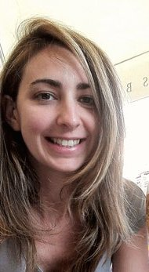
Neuropathic pain during aging
Objective of the internship
Research lines
In our team we investigate therapy for blocking pain in the mouse model:
We work with importin alpha3 ko mice (Marvaldi et al., 2020, Testa et al., 2024)
We measure axonal outgrowth and branching in sensory neurons (Musso, Dotta et al., 2024)
We study molecular mechanism that could block pain (Dotta, Musso et al in preparation)
Future direction is to work with human iPSC sensory neurons
Letizia Marvaldi
(Vercelli’s Lab)
NICO (Orbassano))

Slide 28
Area:
Laboratory
and Bioinformatics
Professors: Ferdinando Di Cunto, Christian Pritz
ferdinando.dicunto@unito.it
christianpritz@gmail.com
SSD: BIO/11 - Molecular Biology

Slide 29
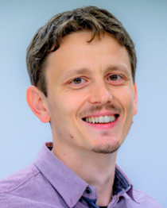
Objective of the internship
The general focus of our group is to investigate the molecular and cellular mechanisms underlying neurodevelopmental disorders and brain tumors, with the aim of identifying new targets for therapy, using molecular and cellular biology technologies, in vitro and in vivo models, bioinformatics and advanced microscopy. Students enrolled in internships in our lab will have the possibility to learn about the practical use of all these approaches as well as about their application to the solution of specific biological problems.
Research lines
Identification and validation of new therapeutic targets for brain tumors treatment, using cultured cell lines and in vivo mouse models
Analysis of the cellular and molecular mechanisms of human primary microcephaly using in vitro cell lines and in vivo mouse models
Analysis of molecular mechanisms underlying human neurodevelopmental disorders by means of the genetically tractable model Caenorhabditis elegans
Analysis of the impact of space flight-related environmental conditions on the function of neuronal systems, by means of the genetically tractable model Caenorhabditis elegans

Slide 30
Area:
Laboratory
and Clinical
Professors: Alessandro Vercelli, Innocenzo Rainero, Paolo Pacca
alessandro.vercelli@unito.it
innocenzo.rainero@unito.it
paolo.pacca@unito.it
SSD: BIO/16, MED/26

Slide 31
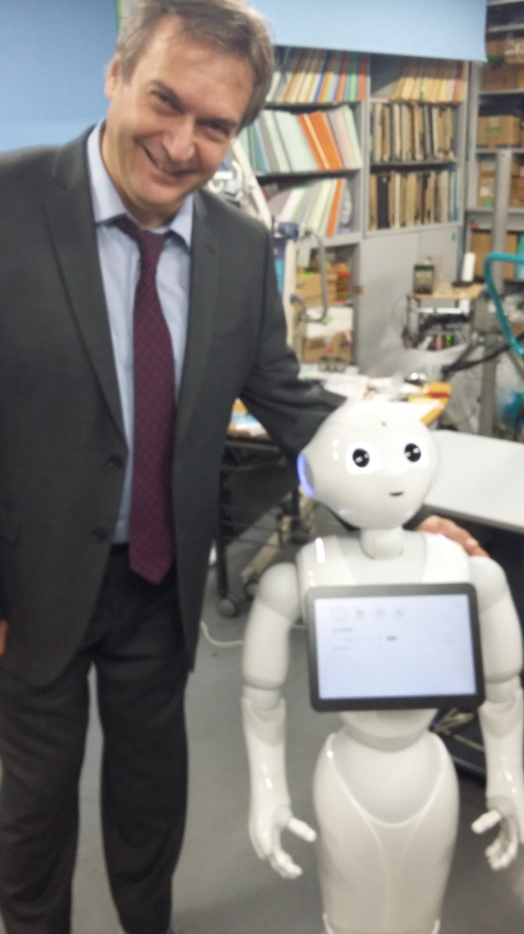
Objective of the internship
The aim is to create a living lab for the use of companion robots in elderly care.
Title of the project: DAISI&RON
Degli Anziani In Salute con Intravides e RObot Nurse
Research lines
to develop advanced human-robot interaction (Human Robot Interface) related to supporting and motivating older adults in active and healthy ageing, including the presentation and monitoring (coaching) of physical exercise and cognitive training.
The project will be performed in collaboration with the Memory Clinic, the company Theoresis and the spinoff Intravides

Slide 32
Area:
Clinical
Professor: Giuseppe Maina
giuseppe.maina@unito.it
SSD: Psychiatry (MED25)

Slide 33
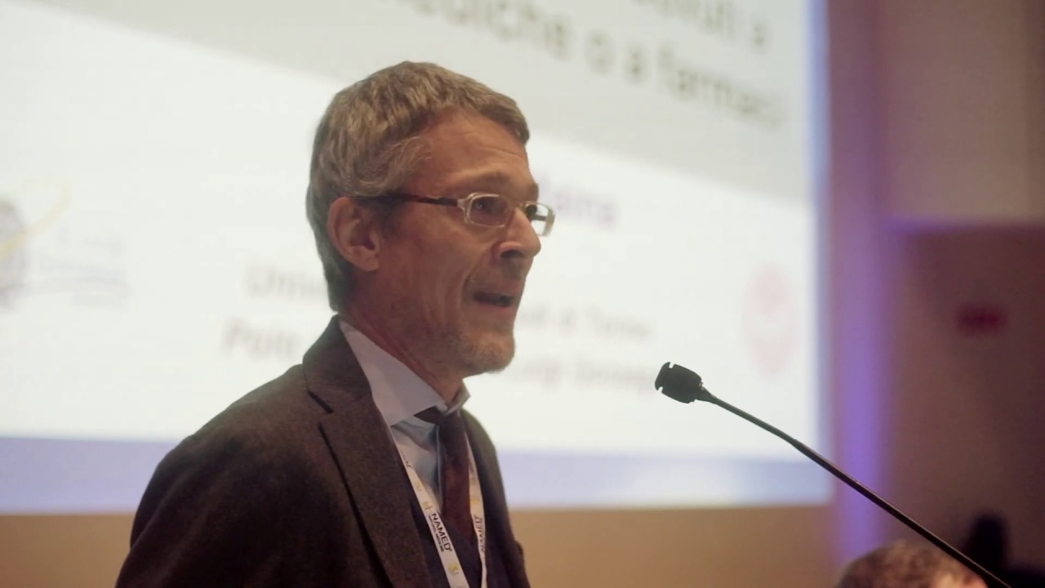
Objective of the internship
Training research experience in a psychiatry and clinical psychopharmacology research group.
The location of the internship is the San Luigi University Hospital.
Research lines
Bipolar Disorder: biomarkers and treament response
Treatment Resistant Depression
Obsessive-Compulsive Disorder and treatment resistance
ADHD: diagnosis and treatment

Slide 34
Area:
Functional Neuroimaging
Professor: Franco Cauda
franco.cauda@unito.it
SSD: M-Psi/02

Slide 35
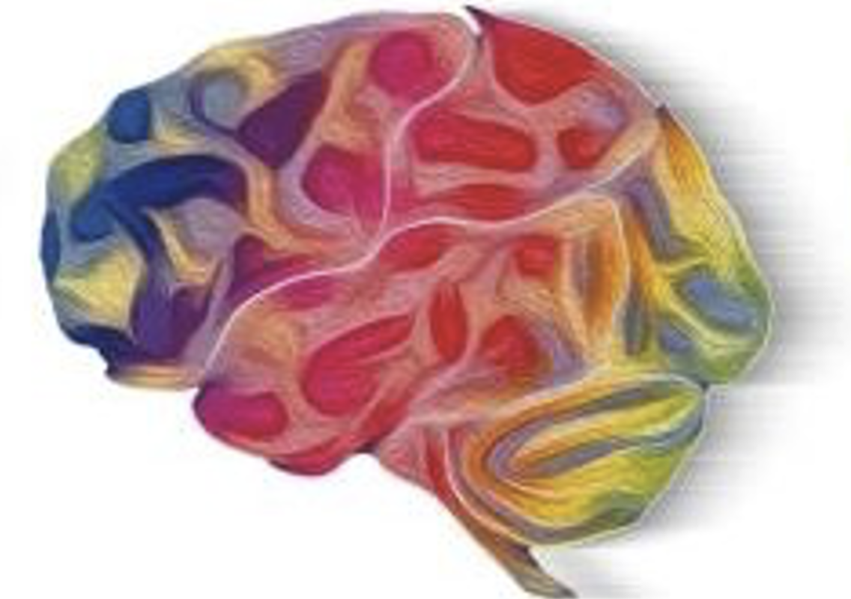
Objective of the internship
The Functional Neuroimaging internship offers biotechnology students practical experience in advanced brain research techniques.
The main objectives are to understand functional MRI (fMRI) and connectivity analyses, develop skills using tools and software for neuroimaging data collection and analysis, and learn to process and interpret neuroimaging data, including voxel-based meta-analyses. Students will also explore the applications of neuroimaging in diagnosing neurological disorders and collaborate with neuroscientists and specialists.
The internship will take place at the CCS-fMRI, a lab located at Koelliker Hospital, established in 2004 with over 100 published papers. This internship equips students with essential skills for contributions to neuroscience.
https://www.osp-koelliker.it/ricerca-koelliker/introduzione.

Slide 36
**Brain Connectivity**: Exploring the neural networks and pathways that connect different brain regions and understanding their role in various cognitive functions and disorders.
**Voxel-based Meta-Analysis**: Conducting comprehensive analyses of neuroimaging data to identify consistent patterns of brain activity and structural changes across multiple studies.
**Propagation of Brain Damage**: Investigating how brain damage spreads through neural networks over time, focusing on mechanisms and potential interventions.
**Innovative Approaches to Dementia and Psychiatric Disorders**: Developing and testing new methods for studying and treating dementia and psychiatric diseases, including novel diagnostic tools and therapeutic strategies.
**Study of Brain Damage Selectivity**: Examining why certain brain regions are more vulnerable to damage and how this selectivity influences disease progression and recovery.
-**Connectivist Approaches to Consciousness**: Analyzing the role of brain connectivity in the emergence and maintenance of consciousness, employing advanced imaging and theoretical models.
**Multisensory Brain Stimulation**: Exploring techniques for stimulating the brain using multiple sensory modalities (e.g., visual, auditory, tactile) to enhance cognitive function and treat neurological disorders.

Slide 37
Area:
Social Neuroscience
Professor: Olga Dal Monte
olga.dalmonte@unito.it
SSD: MPSI-02 / BIO-09

Slide 38
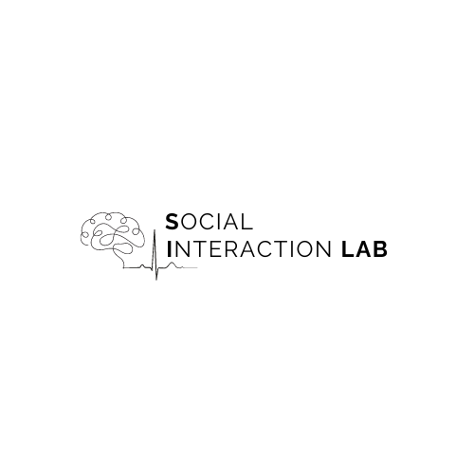
Objective of the internship
The internship’s activities will focus on understanding the neurophysiological substrates involved in complex social behaviors. We address these questions utilizing interdisciplinary theoretical principles and behavioral, physiological (skin conductance, heart rate, and respiration frequency), and neurophysiological (electroencephalography) measurements to complement and extend our understanding of how the body and brain interact during complex social interactions.
Taking a multi-pronged approach, the overall aim is to provide novel basic neuroscientific insights to better inform the mechanisms underlying social dysfunctions and, in the long run, to suggest novel treatments for neuropsychiatric disorders.
The Social Interaction Lab studies different aspects of social behavior such as:
Prosociality and altruism
Interpersonal distance
Affective touch
Dual-physiology synchronization
Cooperation and competition

Slide 39
Area:
Psychology
Professors: Francesca Garbarini,
Carlotta Fossataro,
Valentina Bruno
francesca.garbarini@unito.it
carlotta.fossataro@unito.it
valentina.bruno@unito.it
SSD: M-PSI/02 - psychobiology and physiological psychology

Slide 40
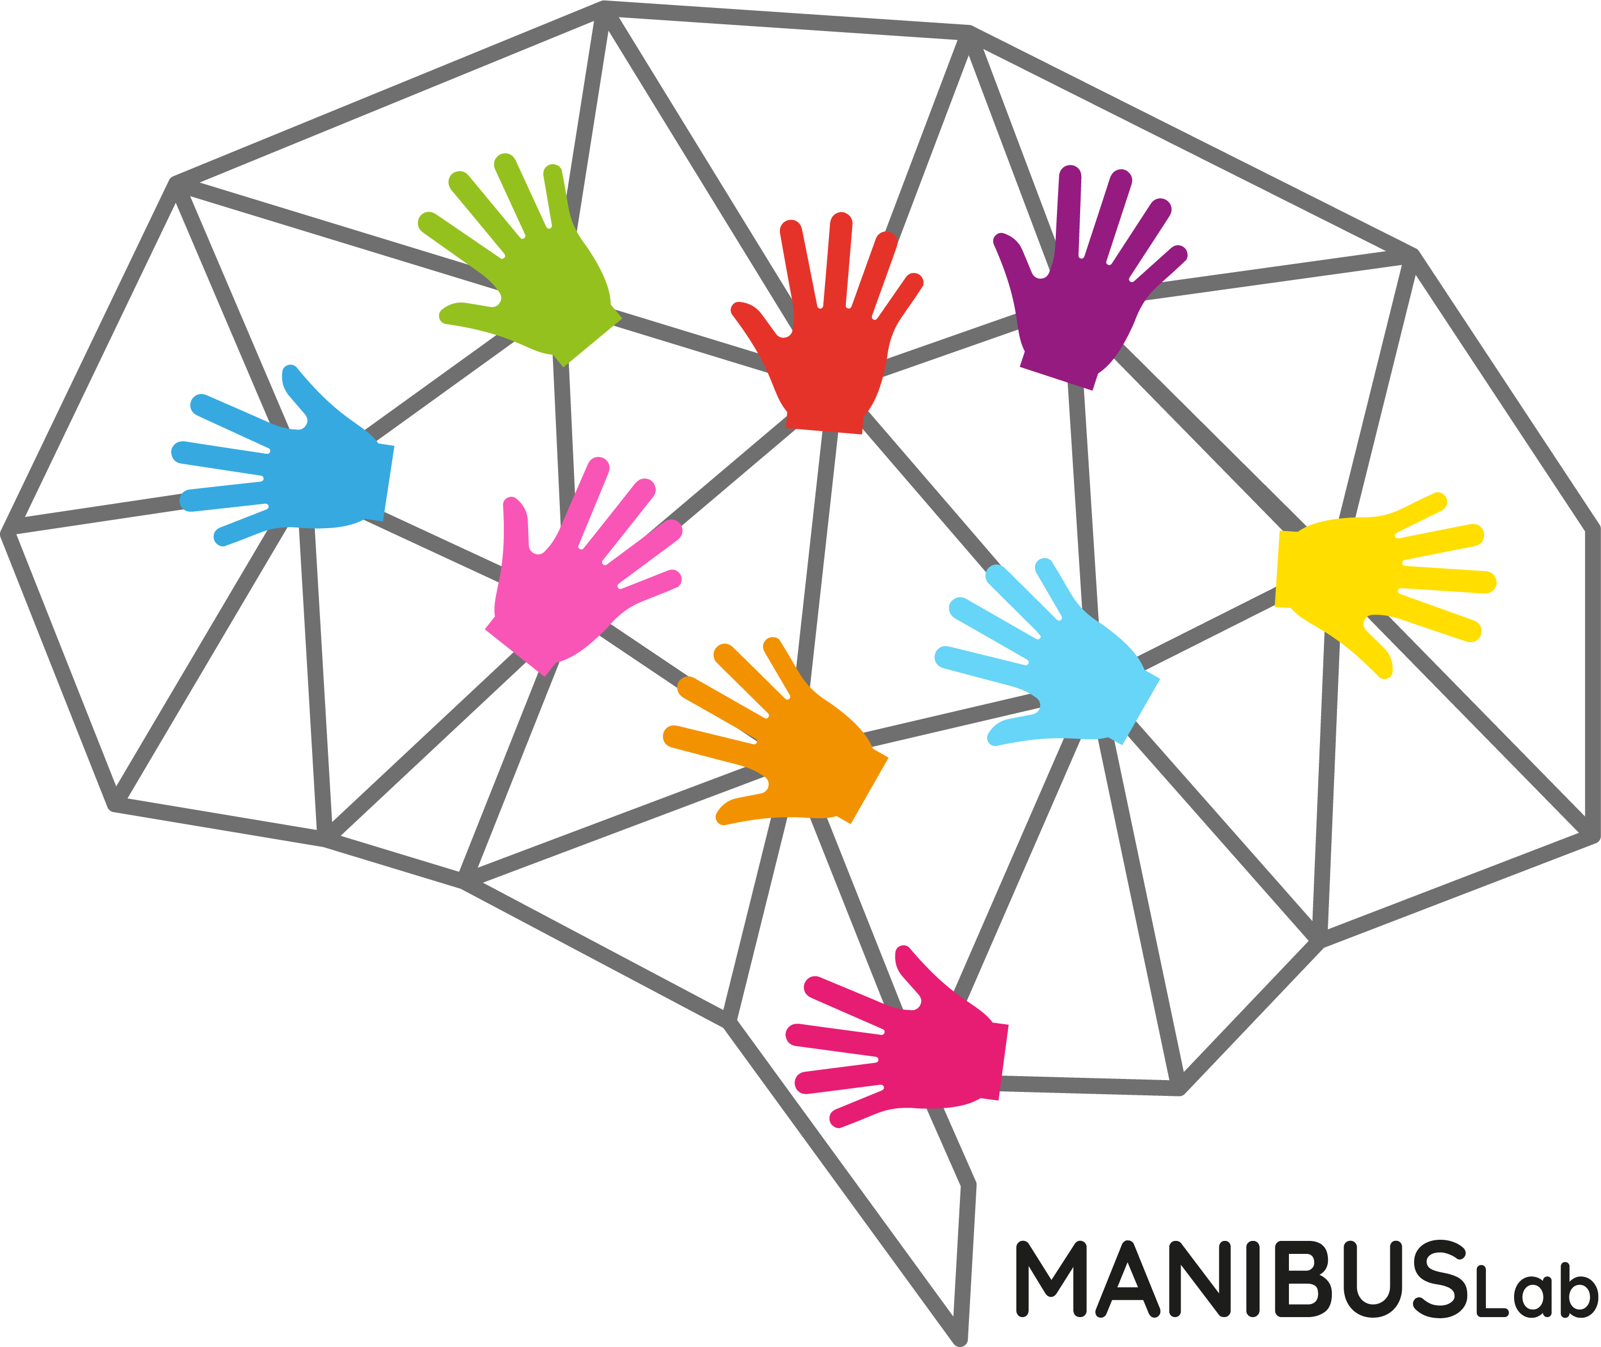
Objective of the internship
The internship's objective is to study the neurophysiological underpinning of human behavior. The trainee will learn to collect and analyze neurophysiological and psychophysiological measures. The traineeship will be held at the HST lab.
MANIBUS Lab mainly deals with body representation, in both normal and pathological conditions, across the life span.
To investigate neurophysiological underpinning of body representation MANIBUS Lab exploits neuroimaging techniques (fMRI, fNIRS and EEG), psychophysiological measures (SCR, EMG, Heartbeat),
experimental paradigms involving non-invasive brain stimulation (tDCS and TMS) and virtual reality.
Visit our website to learn more about us!

Slide 41
Area:
Psychology
Professor: Lorenzo Pia
lorenzo.pia@unito.it
SSD: 11/PSIC-01

Slide 42
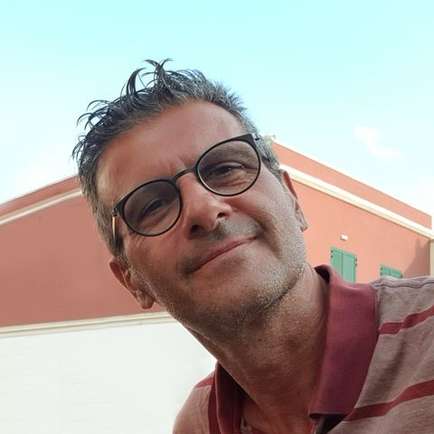
Objective of the internship
Learning the most important methods/techniques of the cognitive neuroscience approach
Bodily self
Neurogastronomy
Sports neuroscience
Dog cognition

Slide 43
Area:
Bioinformatics
Professors:
Federico D’Agata,
Caterina Guiot,
Ilaria Stura
federico.dagata@unito.it
caterina.guiot@unito.it
ilaria.stura@unito.it
SSD: FIS/07 Data Science

Slide 44
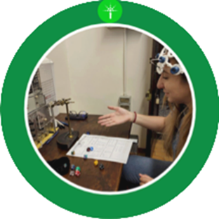
Objective of the internship
BRIGHT: Brain Research in Interactive Game-based HyperTraining
The student will learn how to use the functional Near-Infrared Spectroscopy (fNIRS). In this project, the fNIRS will be used to acquire data from healthy adult volounteers doing complex tasks (role-playing games) to monitor their interaction, synchrony and competition.
The student will also learn how to manage, clean and analyze the data from the acquisition.

Slide 45
Area:
Bioinformatics
Professors: Paolo Provero, Davide Marnetto
paolo.provero@unito.it
davide.marnetto@unito.it
SSD: BIO/11

Slide 46
Objective of the internship
Analysis of multi-omic data to understand the evolution and variation of gene regulation
Intermediate molecular phenotypes for the biological interpretation of the genetic determinants of complex traits
Evolution of gene regulation and the role of transposable elements
Role of archaic introgressed variants in molecular and macroscopic human traits
see https://proverolab.gitlab.io/ for more details

